Slide 1
CNN with Residual Connections
ResNet
Lecture 5
Part 1
Generative AI for Computer Vision

Slide 2
Content
Introduction to ResNet
Residual (SKIP) Connection
Why SKIP connections are advantageous?
Resnet Architecture
Performance of ResNet

Slide 3
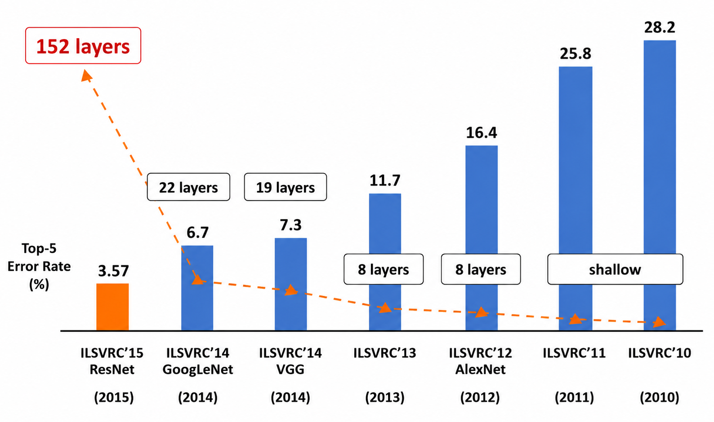
ImageNet Large Scale Visual Recognition Challenge (ILSVRC)
First CNN based winner
Image Source : Hu, Hanqing & Lyu, Jin & Yin, Xiaolin. (2020). Research and Prospect of Image Recognition Based on Convolutional Neural Network. Journal of Physics: Conference Series. 1574. 012161. 10.1088/1742-6596/1574/1/012161.

Slide 4
Challenges for Deep Network
Vanishing gradients
Optimization problem
  Additional layers make the network harder to train.
  The network fails to learn the identity mapping.
Overfitting
Internal Covariate Shift

Slide 5
Activation Function are not enough to handle Vanishing Gradient Problem Completely
Leaky ReLU reduces but does not eliminate the vanishing gradient problem. For negative inputs, its gradient is small but non-zero (typically α < 1). During backpropagation through many layers, these gradients are repeatedly multiplied, causing them to decay exponentially. As a result, very deep networks can still experience vanishing gradients, although the effect is less severe than with standard ReLU, sigmoid, or tanh.
Why Leaky ReLU Does Not Completely Solve the Vanishing Gradient Problem ?
  Small Negative Gradient: For negative inputs, Leaky ReLU uses a small slope α (e.g., 0.01). Although the gradient is non-zero, it is still less than 1, so repeated multiplication across many layers causes gradients to shrink.
  Primarily Addresses Dying ReLU: Leaky ReLU is designed to prevent neurons from becoming permanently inactive ("dying ReLU"), not to completely eliminate vanishing gradients in very deep networks.
  Cumulative Gradient Decay: Even without zero gradients, repeatedly multiplying gradients smaller than 1 during backpropagation causes them to decay exponentially, making training of very deep networks difficult.
To effectively address the vanishing gradient problem in very deep networks, architectures such as Residual Networks (ResNets) use residual (skip) connections that allow gradients to bypass one or more layers, preserving gradient flow and enabling the successful training of much deeper models.

Slide 6
ResNet Basics
ResNet (Residual Network) is a deep convolutional neural network architecture that addresses the degradation problem encountered when training very deep networks.
It introduces residual learning through skip (shortcut) connections, which allow the input of a residual block to bypass one or more convolutional layers and be added directly to the block's output.
Instead of learning a direct mapping, the network learns a residual function enabling more effective gradient propagation during backpropagation and mitigating the vanishing gradient problem.
This design allows the successful training of networks with hundreds of layers, such as ResNet-50, ResNet-101, and ResNet-152.
In computer vision applications, ResNet serves as a powerful feature extractor for tasks including image classification, object detection, semantic segmentation, instance segmentation, and image retrieval.
Its robust hierarchical feature representations, scalability, and compatibility with transfer learning have made it a foundational backbone in numerous state-of-the-art computer vision systems.

Slide 7








Introducing SKIP Connection
Instead of learning the complete mapping H(x), a ResNet learns the residual mapping:
F(x)=H(x)−x
where F(x) represents the difference (residual) between the input and the desired output. Learning only what needs to change [F(x)] is often easier than learning the entire transformation from scratch [H(x)].
$$H\left(x\right)=F\left(x\right)+x$$
$$H(x)$$
ReLU
$$F\left(x\right)+x$$
$$F\left(x\right)=H\left(x\right)−x$$
conv
conv
ReLU
Identity
ReLU
$$F\left(x\right)$$
$$x$$
conv
conv
$$x$$
$$x$$
Plain Layer Learns H(x)
Residual Block Learns F(x)

Slide 8

Advantages of SKIP Connections
By providing a direct pathway for information and gradients to flow across layers, SKIP connections effectively mitigate the vanishing gradient problem, allowing stable training of very deep networks.
Skip connections enable the network to learn identity mappings when additional layers are unnecessary, simplifying the optimization process and preventing performance degradation as network depth increases.
They also accelerate training convergence by facilitating faster gradient propagation during backpropagation.
Furthermore, skip connections promote feature reuse by preserving useful low-level and intermediate representations throughout the network, leading to richer feature extraction.
Their architecture provides implicit regularization, which can reduce overfitting and improve generalization. Collectively, these advantages make skip connections essential for training deeper, more accurate, and more robust neural networks for a wide range of computer vision applications.
Classifier
Plain CNN
Classifier
CNN with skip connections

Slide 9









Normal CNN Nodes
$$a^{[l]}$$
$$z^{[l+1]}{=W}^{[l+1]}a^{[l]}+b^{[l+1]}$$
$$z^{[l+1]}$$
$$a^{[l+1]}=g(z^{[l+1]})$$
$$a^{[l+1]}$$
$$z^{[l+2]}$$
$$z^{[l+2]}= W^{[l+2]}a^{[l+1]}+b^{[l+2]}$$
$$a^{[l+2]}=g\left(z^{\left[l+2\right]}\right)$$
$$a^{[l+2]}$$

Slide 10









Normal CNN Nodes
$$a^{[l]}$$
$$z^{[l+1]}{=W}^{[l+1]}a^{[l]}+b^{[l+1]}$$
$$z^{[l+1]}$$
$$a^{[l+1]}=g(z^{[l+1]})$$
Skip Connection
$$a^{[l+1]}$$
$$z^{[l+2]}= W^{[l+2]}a^{[l+1]}+b^{[l+2]}$$
$$z^{[l+2]}$$
$$a^{[l+2]}=g\left(z^{\left[l+2\right]}+a^{[l]}\right)$$
$$a^{[l+2]}$$
Classifier
Plain CNN
Classifier
CNN with skip connections
Concept: Andrew Ng

Slide 11
Vanishing Gradient Concept
$$W_{h_{1}}$$
Vanishing Gradient Problem
  When these derivatives are small, the gradient signal progressively diminishes as it is back-propagated through the network.
$$h_{1}$$
$$h_{11}$$
$$h_{1i}$$
$$h_{1n}$$
$$W_{h_{2}}$$
$$h_{2}$$
$$h_{21}$$
$$h_{2i}$$
$$h_{2n}$$
$$W_{h_{3}}$$
What happens if the derivatives are small?
$$h_{3}$$
$$h_{31}$$
$$h_{3i}$$
$$h_{3n}$$
$$W_{Y}$$
$$Y_{1}$$
$$Y_{2}$$
$$Y_{p}$$
$$\frac{∂E_{Y}}{∂W_{h1}}=\frac{∂E_{h_{2} }}{∂W_{h_{1}}} ×\frac{∂E_{h_{3}}}{∂W_{h_{2}}}× \frac{∂E_{Y}}{∂W_{h_{3}}}×\frac{∂E_{Y}}{∂W_{Y}}$$
$$E_{Y}=\frac{1}{2}{(D−d)}^{2}$$
$$\frac{∂E_{Y}}{∂W_{Y}}$$

Slide 12

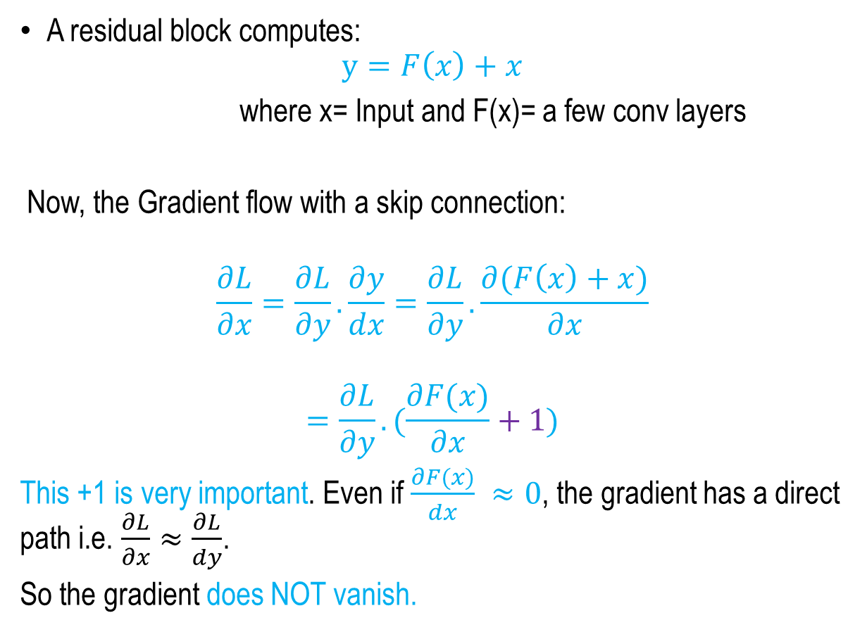



How SKIP Connection helps Vanishing
Gradient Problem ?
A residual block computes:
$$y=F\left(x\right)+x$$
where x= Input and F(x)= a few conv layers
Now, the Gradient flow with a skip connection:
$$\frac{∂L}{∂x}=\frac{∂L}{∂y}.\frac{∂y}{dx}=\frac{∂L}{∂y}.\frac{∂(F\left(x\right)+x)}{∂x}$$
$$=\frac{∂L}{∂y}.(\frac{∂F(x)}{∂x}+1)$$
This +1 is very important. Even if $\frac{∂F(x)}{dx} ≈0$, the gradient has a direct path i.e. $\frac{∂L}{∂x}≈\frac{∂L}{dy}$.
So the gradient does NOT vanish.
ReLU
$$y=F\left(x\right)+x$$
conv
Identity
$$x$$
ReLU
$$F\left(x\right)$$
conv
$$x$$
Residual Block
Figure Credit: Fei Li et. al.

Slide 13



Identity Mapping with SKIP Connections
If additional layers are unnecessary, the network can easily learn an identity mapping.
X
X
z^{[l+2]} = w^{[l+2]} a^{[l+1]}+b^{[l+2]}
Base Network
a^{[l+2]}=g(z^{[l+2]}+a^{[l]})
=g(w^{[l+2]} a^{[l+1]}+b^{[l+2]} +a^{[l]})
Base Network
$$a^{[l]}$$
Extra Layers with Skip Connections
$$a^{[l]}$$
$$a^{[l+2]}$$
Concept: Andrew Ng

Slide 14
Identity Mapping with SKIP Connections
If additional layers are unnecessary, the network can easily learn an identity mapping.
X
X
z^{[l+2]} = w^{[l+2]} a^{[l+1]}+b^{[l+2]}
a^{[l+2]}=g(z^{[l+2]}+a^{[l]})
=g(w^{[l+2]} a^{[l+1]}+b^{[l+2]} +a^{[l]})
if w^{[l+2]}=0 and b^{[l+2]} =0
=g(w^{[l+2]} a^{[l+1]}+b^{[l+2]} +a^{[l]})=g(a^{[l]})
Base Network
Base Network
$$a^{[l]}$$
Extra Layers with Skip Connections
$$a^{[l]}$$
$$a^{[l+2]}$$
Concept: Andrew Ng

Slide 15
Advantages of SKIP Connections
Faster convergence
  Better gradient flow = faster trainig
  Less sensitive to initialization
  More stable training
Better feature reuse
  Reuses low-level features (edges, textures)
  Preserves spatial information
  Improves performance in vision tasks

Slide 16
Advantages of SKIP Connections
Regularization effect :
  Skip connections make the network behave like many shallower networks.
  This improves generalization to unseen data.
  As a result, it helps reduce overfitting.
Robustness to Network Depth :
  Skip connections allow additional layers without causing optimization difficulties.
  Reduces the risk of vanishing gradients and makes deep networks easier to optimize.
  Facilitates the design and training of very deep architectures.
  Adds no trainable parameters or complexity.

Slide 17




ResNet Architecture
Full ResNet architecture
  ResNet architecture design facilitates efficient gradient propagation, mitigates the vanishing gradient problem, and enables the successful training of networks with depths of 50, 101, 152, or even more layers.
Softmax
FC 1000
POOL
3 x 3 conv, 512
3 x 3 conv, 512
ReLU
3 x 3 conv, 512
3 x 3 conv, 512
$$y=F\left(x\right)+x$$
3 x 3 conv, 512
3 x 3 conv, 512, / 2
conv
Identity
3 x 3 conv, 128
3 x 3 conv, 128
$$x$$
3 x 3 conv, 128
ReLU
3 x 3 conv, 128
$$F\left(x\right)$$
3 x 3 conv, 128
conv
3 x 3 conv, 128, / 2
3 x 3 conv, 64
3 x 3 conv, 64
3 x 3 conv, 64
$$x$$
3 x 3 conv, 64
3 x 3 conv, 64
3 x 3 conv, 64, / 2
Residual Block
POOL
7 x 7 conv, 64 / 2
INPUT
Source: Kaiming He, Xiangyu Zhang, Shaoqing Ren, Jian Sun, Deep Residual Learning for Image Recognition,

Slide 18




ResNet Architecture
Full ResNet architecture
  ResNet architecture design facilitates efficient gradient propagation, mitigates the vanishing gradient problem, and enables the successful training of networks with depths of 50, 101, 152, or even more layers.
  A typical ResNet architecture begins with a 7 × 7 convolution layer (64 filters, stride 2), followed by batch normalization, ReLU activation, and a 3 × 3 max-pooling layer.
Softmax
FC 1000
POOL
3 x 3 conv, 512
3 x 3 conv, 512
ReLU
3 x 3 conv, 512
3 x 3 conv, 512
$$y=F\left(x\right)+x$$
3 x 3 conv, 512
3 x 3 conv, 512, / 2
conv
Identity
3 x 3 conv, 128
3 x 3 conv, 128
$$x$$
3 x 3 conv, 128
3 x 3 conv , 128
Filters, /2 spatially
With Stride 2
ReLU
3 x 3 conv, 128
$$F\left(x\right)$$
3 x 3 conv, 128
conv
3 x 3 conv, 128, / 2
3 x 3 conv, 64
3 x 3 conv, 64
3 x 3 conv , 64
Filters
3 x 3 conv, 64
$$x$$
3 x 3 conv, 64
3 x 3 conv, 64
3 x 3 conv, 64, / 2
Residual Block
POOL
Beginning CONV layer
7 x 7 conv, 64 / 2
INPUT
Source: Kaiming He, Xiangyu Zhang, Shaoqing Ren, Jian Sun, Deep Residual Learning for Image Recognition,

Slide 19




ResNet Architecture
Full ResNet architecture
  ResNet architecture design facilitates efficient gradient propagation, mitigates the vanishing gradient problem, and enables the successful training of networks with depths of 50, 101, 152, or even more layers.
  A typical ResNet architecture begins with a 7 × 7 convolution layer (64 filters, stride 2), followed by batch normalization, ReLU activation, and a 3 × 3 max-pooling layer.
  The network is then organized into four sequential stages of residual blocks, where each stage extracts increasingly complex features while progressively reducing the spatial dimensions through strided convolutions.
Softmax
FC 1000
POOL
3 x 3 conv, 512
3 x 3 conv, 512
ReLU
3 x 3 conv, 512
3 x 3 conv, 512
$$y=F\left(x\right)+x$$
3 x 3 conv, 512
3 x 3 conv, 512, / 2
conv
Identity
3 x 3 conv, 128
3 x 3 conv, 128
$$x$$
3 x 3 conv, 128
ReLU
3 x 3 conv, 128
$$F\left(x\right)$$
3 x 3 conv, 128
conv
3 x 3 conv, 128, / 2
3 x 3 conv, 64
3 x 3 conv, 64
3 x 3 conv, 64
$$x$$
3 x 3 conv, 64
3 x 3 conv, 64
3 x 3 conv, 64, / 2
Residual Block
POOL
7 x 7 conv, 64 / 2
INPUT
Source: Kaiming He, Xiangyu Zhang, Shaoqing Ren, Jian Sun, Deep Residual Learning for Image Recognition,

Slide 20




ResNet Architecture
Full ResNet architecture
  After the final residual stage, global average pooling aggregates the feature maps into a single feature vector, which is passed to a single fully connected layer followed by a softmax classifier for prediction.
Only one FC 1000 to output classes
Softmax
Global average pooling layer after last Conv layer
FC 1000
POOL
3 x 3 conv, 512
3 x 3 conv, 512
ReLU
3 x 3 conv, 512
3 x 3 conv, 512
$$y=F\left(x\right)+x$$
3 x 3 conv, 512
3 x 3 conv, 512, / 2
conv
Identity
3 x 3 conv, 128
3 x 3 conv, 128
$$x$$
3 x 3 conv, 128
ReLU
3 x 3 conv, 128
$$F\left(x\right)$$
3 x 3 conv, 128
conv
3 x 3 conv, 128, / 2
3 x 3 conv, 64
3 x 3 conv, 64
3 x 3 conv, 64
$$x$$
3 x 3 conv, 64
3 x 3 conv, 64
3 x 3 conv, 64, / 2
Residual Block
POOL
7 x 7 conv, 64 / 2
INPUT
Source: Kaiming He, Xiangyu Zhang, Shaoqing Ren, Jian Sun, Deep Residual Learning for Image Recognition,

Slide 21
ResNet Architecture
Full ResNet architecture
  In shallow variants such as ResNet-18 and ResNet-34, basic residual blocks containing two 3 × 3 convolutional layers are used, whereas deeper variants like ResNet-50, ResNet-101, and ResNet-152 employ bottleneck residual blocks consisting of 1 × 1, 3 × 3, and 1 × 1 convolutions to improve computational efficiency.
Softmax
FC 1000
POOL
3 x 3 conv, 512
3 x 3 conv, 512
3 x 3 conv, 512
3 x 3 conv, 512
Total depths of 34,50,101 or 152
Layers for ImageNet
3 x 3 conv, 512
3 x 3 conv, 512, / 2
3 x 3 conv, 128
3 x 3 conv, 128
3 x 3 conv, 128
3 x 3 conv, 128
3 x 3 conv, 128
3 x 3 conv, 128, / 2
3 x 3 conv, 64
3 x 3 conv, 64
3 x 3 conv, 64
3 x 3 conv, 64
3 x 3 conv, 64
3 x 3 conv, 64, / 2
POOL
7 x 7 conv, 64 / 2
INPUT
Source: Kaiming He, Xiangyu Zhang, Shaoqing Ren, Jian Sun, Deep Residual Learning for Image Recognition

Slide 22
ResNet Architecture
Full ResNet architecture
  In shallow variants such as ResNet-18 and ResNet-34, basic residual blocks containing two 3 × 3 convolutional layers are used, whereas deeper variants like ResNet-50, ResNet-101, and ResNet-152 employ bottleneck residual blocks consisting of 1 × 1, 3 × 3, and 1 × 1 convolutions to improve computational efficiency.
  Owing to its residual connections, ResNet achieves high accuracy while maintaining stable optimization, making it one of the most influential architectures in computer vision for tasks such as image classification, object detection, semantic segmentation, and transfer learning.
Softmax
FC 1000
POOL
3 x 3 conv, 512
3 x 3 conv, 512
3 x 3 conv, 512
3 x 3 conv, 512
Total depths of 34,50,101 or 152
Layers for ImageNet
3 x 3 conv, 512
3 x 3 conv, 512, / 2
3 x 3 conv, 128
3 x 3 conv, 128
3 x 3 conv, 128
3 x 3 conv, 128
3 x 3 conv, 128
3 x 3 conv, 128, / 2
3 x 3 conv, 64
3 x 3 conv, 64
3 x 3 conv, 64
3 x 3 conv, 64
3 x 3 conv, 64
3 x 3 conv, 64, / 2
POOL
7 x 7 conv, 64 / 2
INPUT
Source: Kaiming He, Xiangyu Zhang, Shaoqing Ren, Jian Sun, Deep Residual Learning for Image Recognition

Slide 23

ResNet Architecture
ResNet-50 and deeper use bottleneck layers for more efficient computation, similar to GoogLeNet.
28 x 28 x 256 Output
1x1 conv, 256 filters projects back to 256 feature maps (28x28x256)
1 x 1 conv, 256
Identity
3x3 conv operates over only 64 feature maps
$$x$$
3 x 3 conv, 64
1x1 conv, 64 filters to project to 28x28x64
1 x 1 conv, 64
28 x 28 x 256 Input
Residual Block
Source: Kaiming He, Xiangyu Zhang, Shaoqing Ren, Jian Sun, Deep Residual Learning for Image Recognition

Slide 24
ResNet Architecture
34 layer residual
7x7 conv,64, /2
3x3 conv,64
3x3 conv,64
3x3 conv,64
3x3 conv,64
3x3 conv,64
3x3 conv,64
3x3 conv,128, /2
3x3 conv,128
3x3 conv,128
3x3 conv,128
3x3 conv,128
3x3 conv,128
3x3 conv,128
3x3 conv,128
3x3 conv,256, /2
3x3 conv,256
3x3 conv,256
3x3 conv,256
3x3 conv,256
3x3 conv,256
3x3 conv,256
3x3 conv,256
3x3 conv,256
3x3 conv,256
3x3 conv,256
3x3 conv,256
3x3 conv,512, /2
3x3 conv,512
3x3 conv,512
3x3 conv,512
3x3 conv,512
3x3 conv,512
FC 1000
Image
Pool, / 2
avg pool
34 layer plain
7x7 conv,64, /2
3x3 conv,64
3x3 conv,64
3x3 conv,64
3x3 conv,64
3x3 conv,64
3x3 conv,64
3x3 conv,128, /2
3x3 conv,128
3x3 conv,128
3x3 conv,128
3x3 conv,128
3x3 conv,128
3x3 conv,128
3x3 conv,128
3x3 conv,256, /2
3x3 conv,256
3x3 conv,256
3x3 conv,256
3x3 conv,256
3x3 conv,256
3x3 conv,256
3x3 conv,256
3x3 conv,256
3x3 conv,256
3x3 conv,256
3x3 conv,256
3x3 conv,512, /2
3x3 conv,512
3x3 conv,512
3x3 conv,512
3x3 conv,512
3x3 conv,512
FC 1000
Image
Pool, / 2
avg pool
3x3 conv,64
3x3 conv,64
3x3 conv,128
3x3 conv,128
3x3 conv,256
3x3 conv,256
3x3 conv,256
3x3 conv,256
3x3 conv,512
3x3 conv,512
3x3 conv,512
3x3 conv,512
3x3 conv,512
3x3 conv,512
3x3 conv,512
3x3 conv,512
FC 4096
FC 4096
FC 1000
VGG-19
Image
Pool, / 2
Pool, / 2
Pool, / 2
Pool, / 2
Pool, / 2
Output
Size : 14
Output
Size : 7
Output
Size : 1
Output
Size : 224
Output
Size : 112
Output
Size : 56
Output
Size : 28
Source: Kaiming He, Xiangyu Zhang, Shaoqing Ren, Jian Sun, Deep Residual Learning for Image Recognition

Slide 25
Summary
Introduction to ResNet
Residual (SKIP) Connection
Why SKIP connections are advantageous?
Res-Net Architecture
Performance of Res-Net

Slide 26
CNN Model Architectures -II
Next
Lecture 5: Part II
Generative AI for Computer Vision

